Slide 1
Memory Segmentation of 8086

Slide 2
Problem : Memory accessed by 8085
Memory and Processor are the different chips.
Memory is used to stored code, stack and data.
Code is referred as a program which is always stored in sequence.
Data can stored in any direction.
Stack is used to stored the data in last in first out manner.
Memory
0000
Program
Code
At some point they all are going to overwrite each other.
Solution :
Stack
Memory is divided into different parts which called as segments to automatically prevent the overwriting .
1 MB
Data
In 8086 memory segmentation concept was invented to avoid overwriting.
Extra
Programmers are responsible to create the segments at the time of initialization when start the program.
Processor is responsible to manage the segments (avoid overwriting)
FFFF

Slide 3
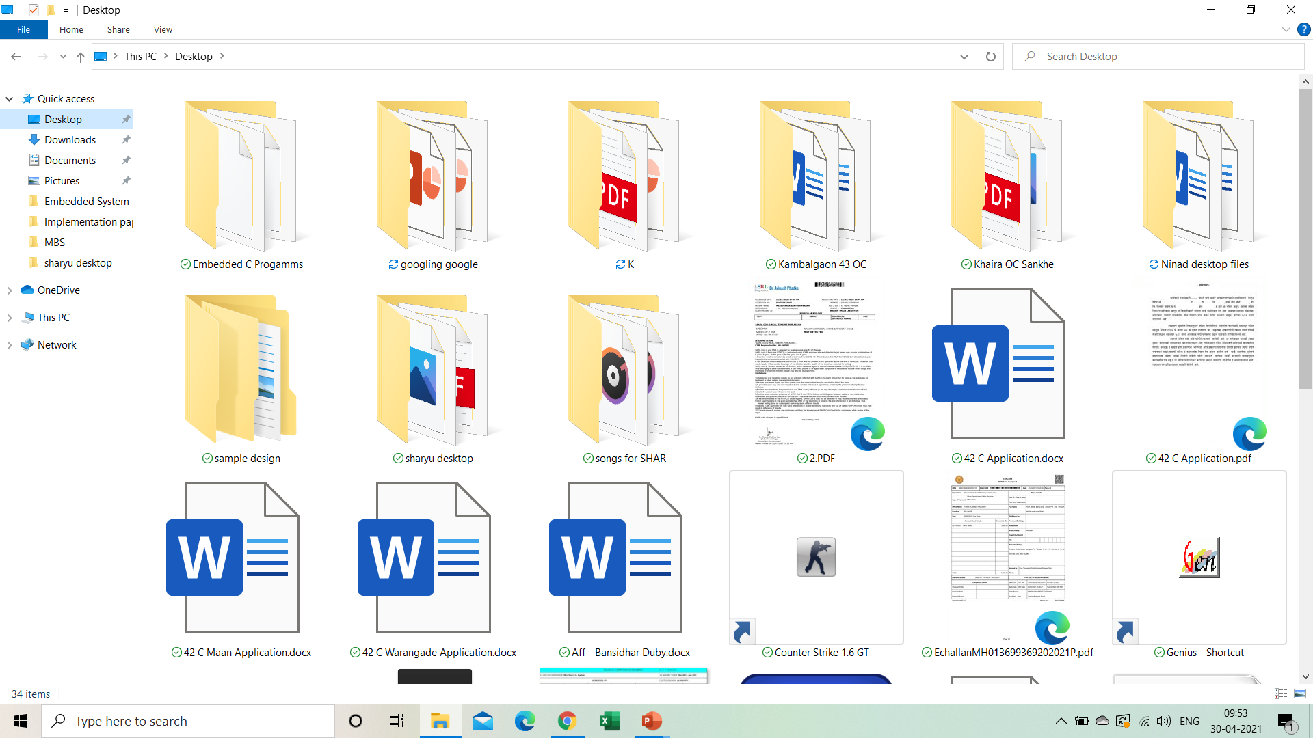
Files and fodders are the example of segmentation.
There are two types of addresses :
Virtual address
Physical address
File/folder name is virtual address-known to programmer
Actual location in memory is physical address – unknown to programmer.

Slide 4
If address bus size is 8 bit then we have 2⁸ = 256 unique address of memory locations.
If address bus size is 16 bit then we have 2¹⁶ = 65535 = 64k memory locations.
If we want 1MB memory hence 8086 having 2²⁰ = 1MB i.e. 20 bit address bus.
00000
Memory
Code
PA = 12345
Stack
0001 0010 0011 0100 0101 = 20 bit
Data
Individual memory location size is 8 bit.
Hence the address bus size is 20 bit then 2 and ½ memory locations are required to store one instruction in case of 8086.
Which means wastage of ½ byte.
If 16 bit address bus then no wastage of memory locations.
Extra
FFFFF
We want 20 bit address bus to increase the memory size
We want 16 bit address to provide equal memory locations
To achieve this we are going to use 16 bit virtual address which will converted into 20 bit physical address.

Slide 5
00000
Memory
Virtual address = segment address + offset address
Segment Addr
Both are 16 bit which means compatible.
Code
16 bit
Offset Addr
Segment Addr gives the starting address of segment
Offset Addr gives the location which is present at that segment.
16 bit
Stack
College
CSE
C01
C02
C03
Data
Example :
IT
I01
I02
I03
Departments
Extra
CI01
CI02
CI03
CIVIL
FFFFF
To call particular student from college
To call C01
To call C03
Segment Addr = C
offset Addr = 01
Segment Addr = C
offset Addr = 03
No need to change segment address when location is in same segment
Segment Addr = Department Name
offset Addr = roll number

Slide 6
There are three addresses :
Physical address
Not given by programmer
2. Segment address
Part of virtual address which is given only once
3. Offset address
Part of virtual address which is changed.

Slide 7
Offset addresses are limited they are starting with 0000 to FFFF because they are 16 bits.
Maximum size of segment
= 2¹⁶ = 2⁶ X 2¹⁰ = 64 X 1KB = 64 KB
Memory
8086
00000
0000
Code
Seg reg | Off reg
CS | IP
SS | SP & BP
DS | SI
ES | DI
FFFF
1000
2345
12345 H
20 bit address bus
0000
Stack
FFFF
Processor gives the physical addr
^{Which is 20 bit}
0000
Data
8086 having segment registers which are used to store the segment address and offset address of memory
PA = Seg x 10H + offset
FFFF
0000
Extra
FFFFF
FFFF
When processor wants to execute instruction from memory CS and IP is given
PA = Seg x 10H + offset
1000 x 10H + 2345
10000 + 2345
PA = 12345 H
Processor having 20 bit address bus

Slide 8
If CS is 1000 then Code segment will actually start with 10000
Memory
8086
CS =1000
10000
0000
Code
Seg reg | Off reg
CS | IP
SS | SP & BP
DS | SI
ES | DI
FFFF
1FFFF
1000
2345
0000
Stack
3000
SS =3000
30000
3FFFF
FFFF
DS =5000
50000
0000
54210
52345
Data
DS= 5421
34670
DS= ???
DS= 3467
FFFF
5FFFF
70000
0000
Extra
If SS is 3000 then Code segment will actually start with 30000
ES =7000
7FFFF
FFFF
If DS is 5000 then Code segment will actually start with 50000
Suppose we want to start DS from any random number
*****A segment can not begin at any location you want, it has to begin at location which is multiple of 10
If ES is 7000 then Code segment will actually start with 70000

Slide 9
What is the minimum size of segment ????
Data segment starts with 52340 in memory
8086
52340
52341
We want only this locations after this we want next segment i.e. extra segment.
Seg reg | Off reg
CS | IP
SS | SP & BP
DS | SI
ES | DI
52342
Minimum size of segment is
16 bytes.
52342
What is the next segment address????
52343
5234
5234F
52350
Because it is not multiple by 10
Because it is multiple by 10
16 = 10 H

Slide 10
Memory Segmentation of 8086 for exam

Slide 11
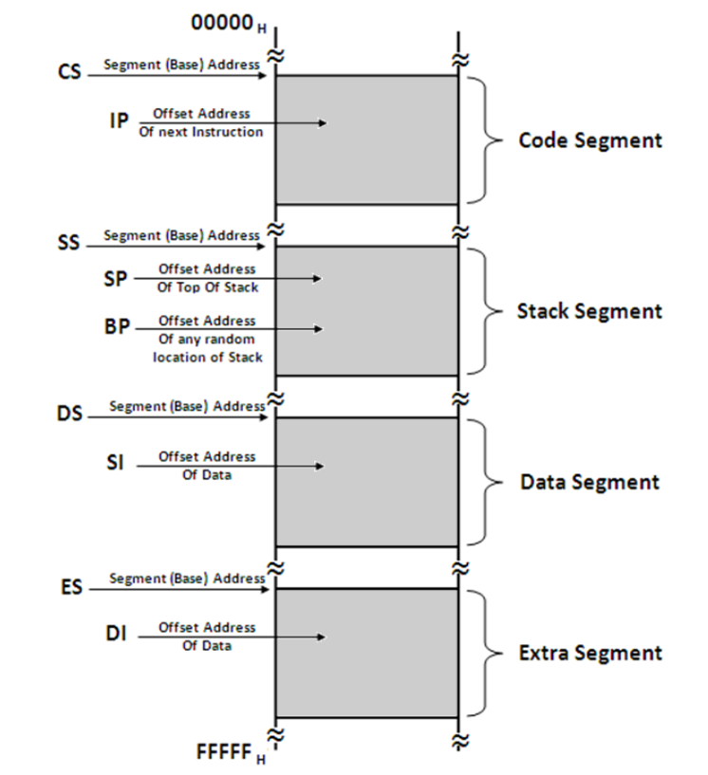
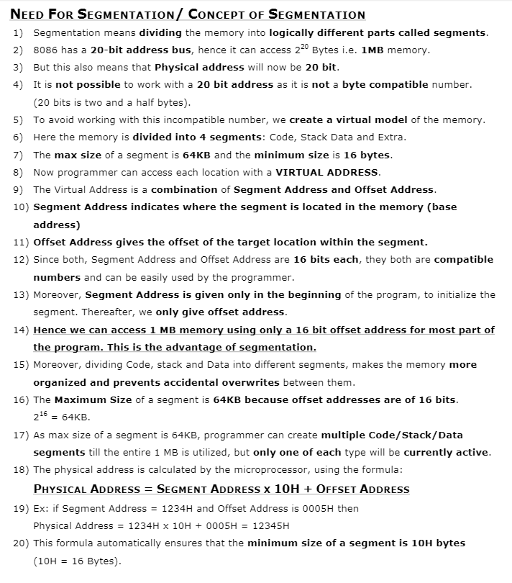

Slide 12
